Slide 1
Cs 321 Team Annex
Richard Blotevogel
Joshua Koehn
Brian Olsen

Slide 2
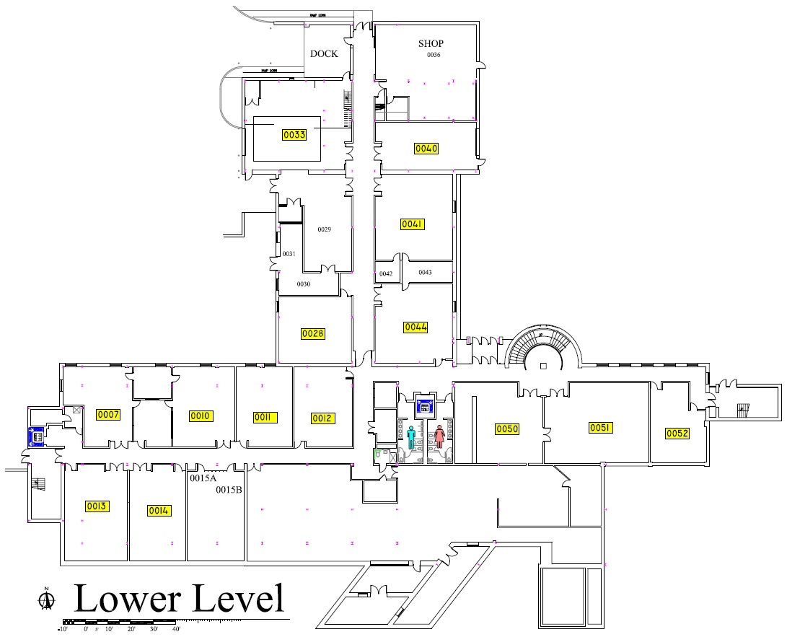
Navigation Software
Touch-screen Kiosk
Staff Information
Room Information

Slide 3
Questions:
Wanted to know what kind of layout the user would prefer.
What information they would like displayed.
How to present the directions.
Insights:
Display less information over multiple windows.
Wanted basic information for the faculty page.
Preferred both written and visual directions when finding room.
Wanted a layout that was easy to use and follow.

Slide 4
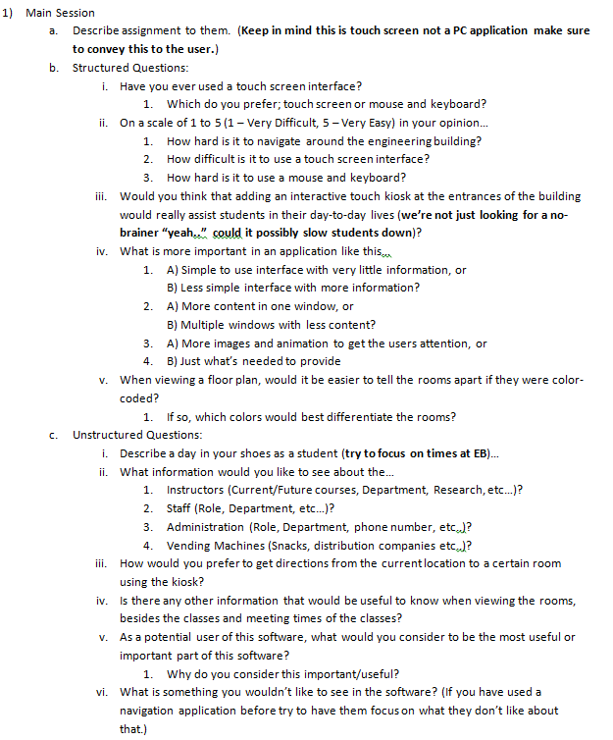

Slide 5
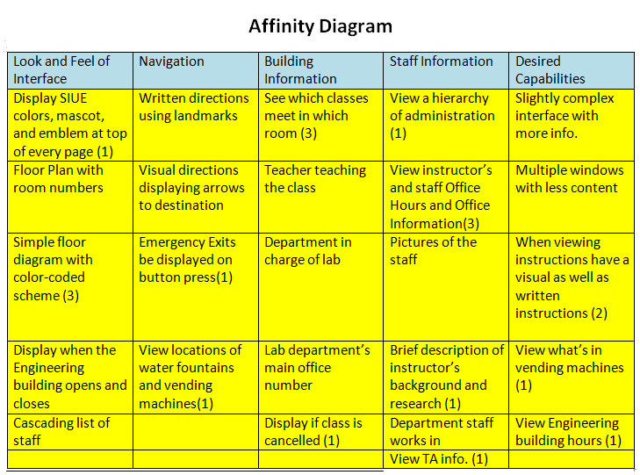
Categories:
Staff info.
Desired capabilities
Navigation
Look and feel
Concerns:
Simplistic layout
Easy to use directions
How to display staff information

Slide 6
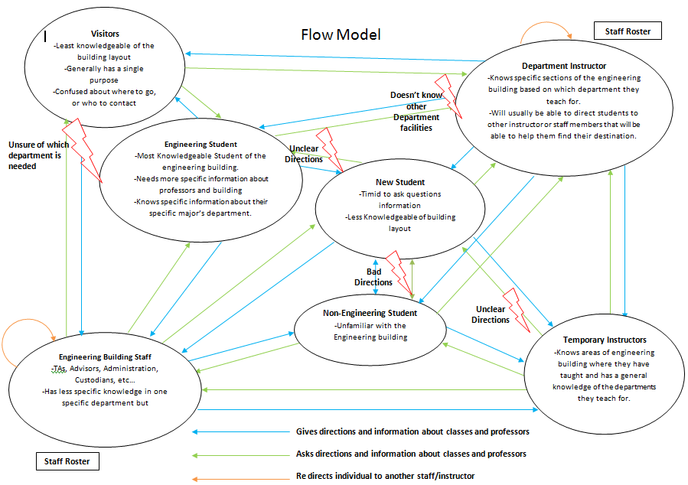
Communication & Interaction
People - Instructors - Eng. Staff - Eng. Students - Temp Instructors - Non-Eng. Student - New Student - Visitor
Issues - Unclear Instructions - “I only know about my department” - Vague understanding of where to go
Notes:
Talk about each individuals responsibilities and then explain where some issues arise

Slide 7
Notes:
We forgot to add interactions outside of conversations. (i.e. walking someone to their destination, directing them to the dean’s office or a department office for directions, or even pointing out the signs on the wall)

Slide 8
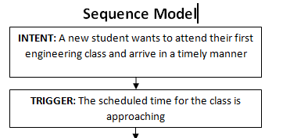
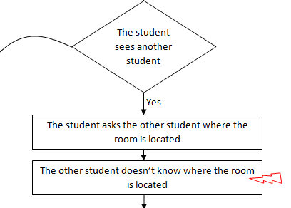
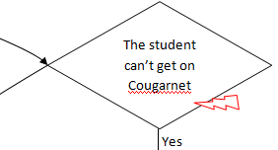
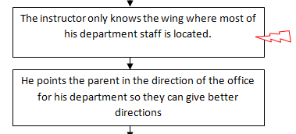
Breakdown of tasks
Tasks -Attending class and arriving on time
-Finding an instructor’s Office -A parent finding the chair of their child's major
Patterns/Issues -Accessing information through web -The current system relies heavily on people
Notes:
Explain one task in some detail and then compare the next two and then explain the patterns.
The problem with our sequence model was we missed some areas where they could be a conditional instead of a linear walkthrough

Slide 9
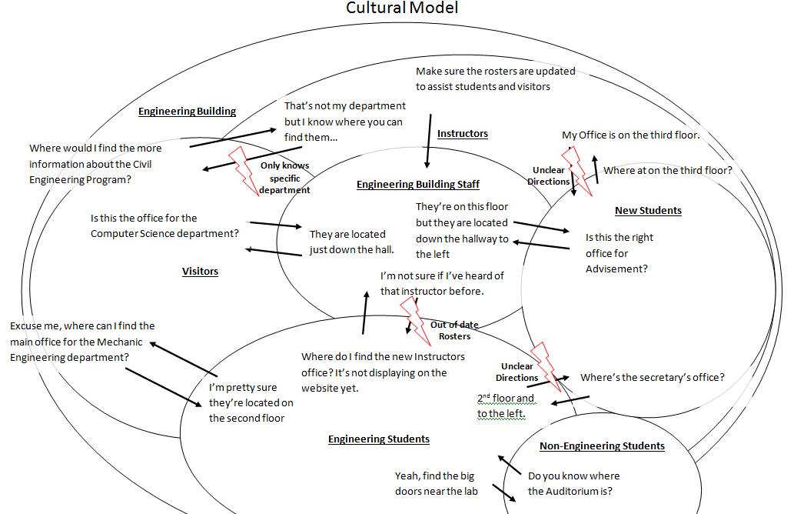
Influences & Policies
Signs posted in hallways
Classrooms have lists of their classes posted outside their doors
Some instructors post their classes and office hours outside their offices

Slide 10
Notes:
The issues we had on this model was that we failed in displaying the policies and procedures
Where are the signs posted? Who posts them? Classrooms have lists of their classes posted outside the door. Some instructors post their classes and office hours outside their offices. Some departments post class schedules and instructor office hours outside their department secretary’s office door

Slide 11
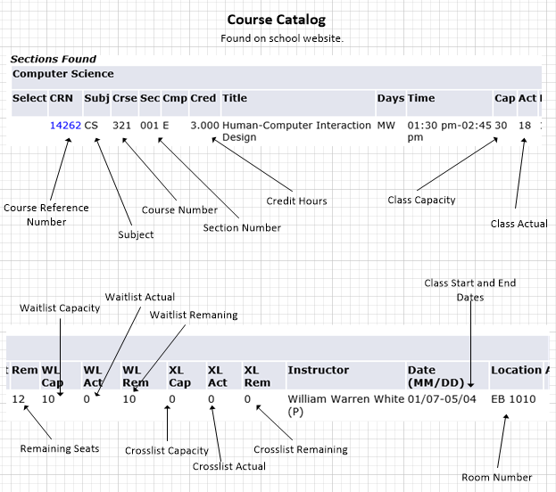
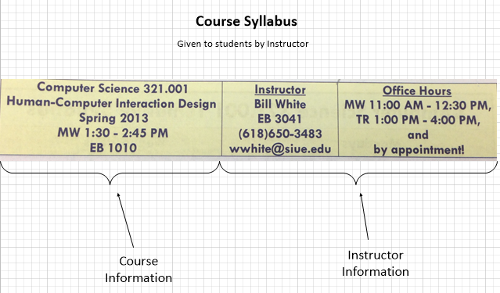
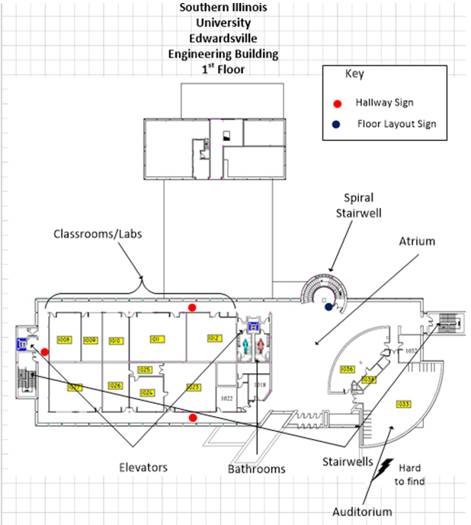
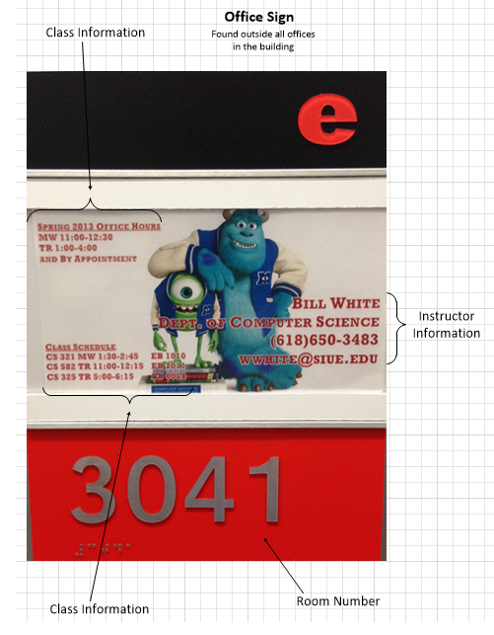
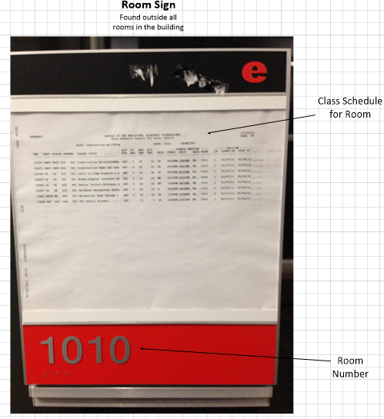
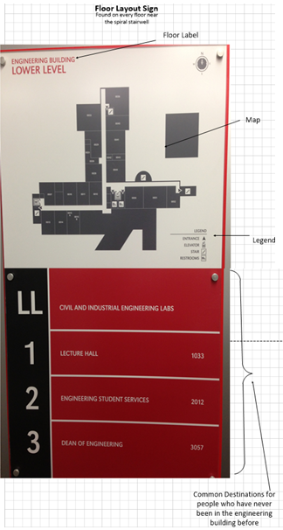
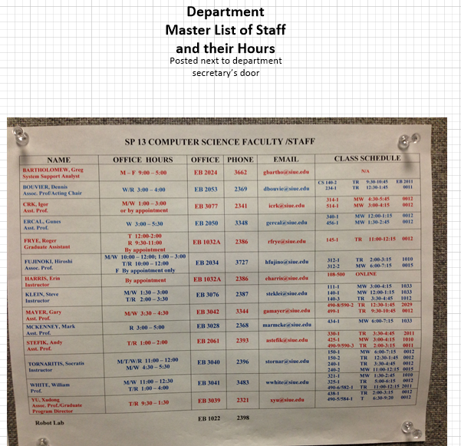
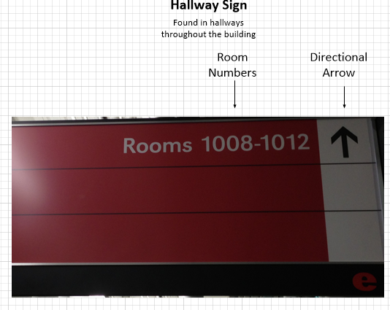
Physical Models
Artifact Models
Labeled any items of interest
Labeled any items of interest
Conflict
Location of artifact
Key
Model for each floor of the engineering building
Other artifact models……
Notes:
I know it looks messy here, but it looks good during the presentation.

Slide 12
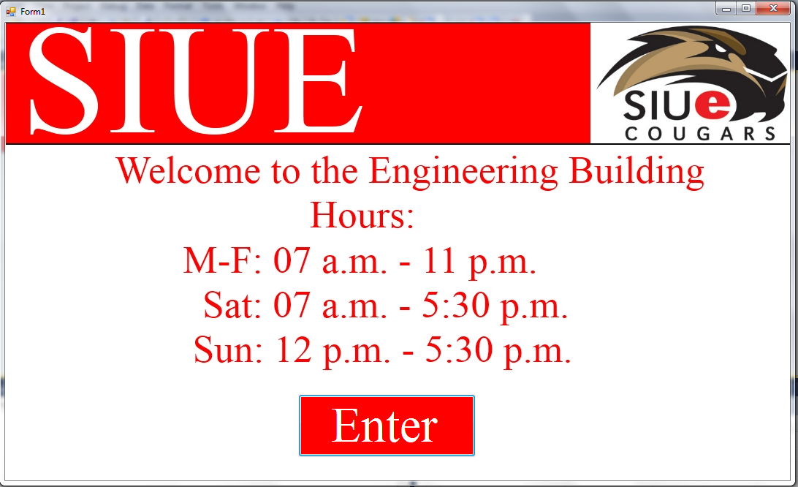
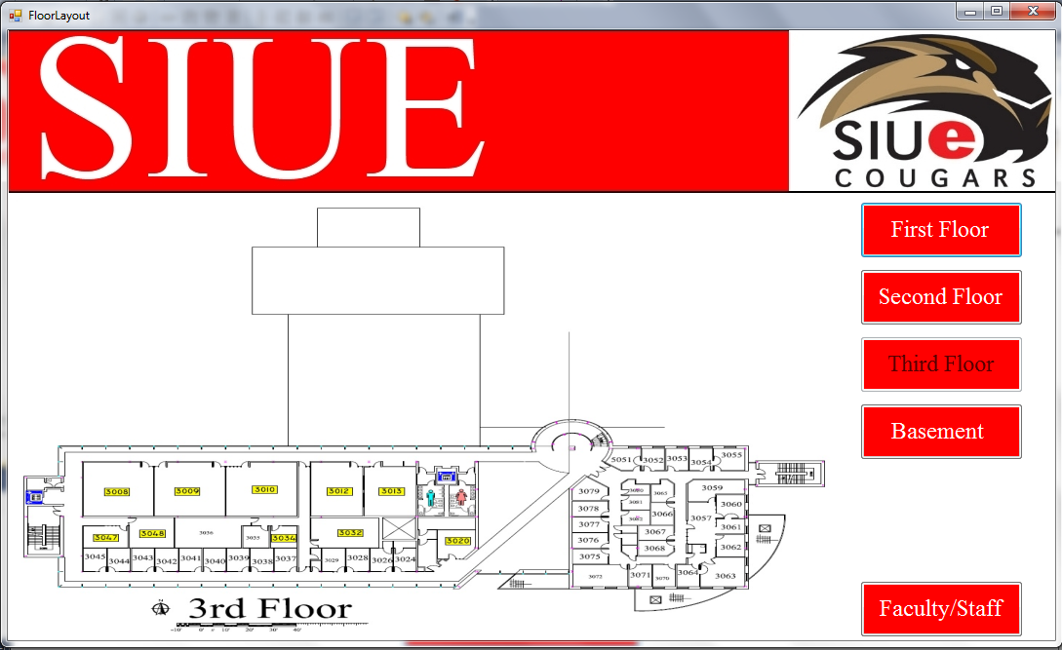
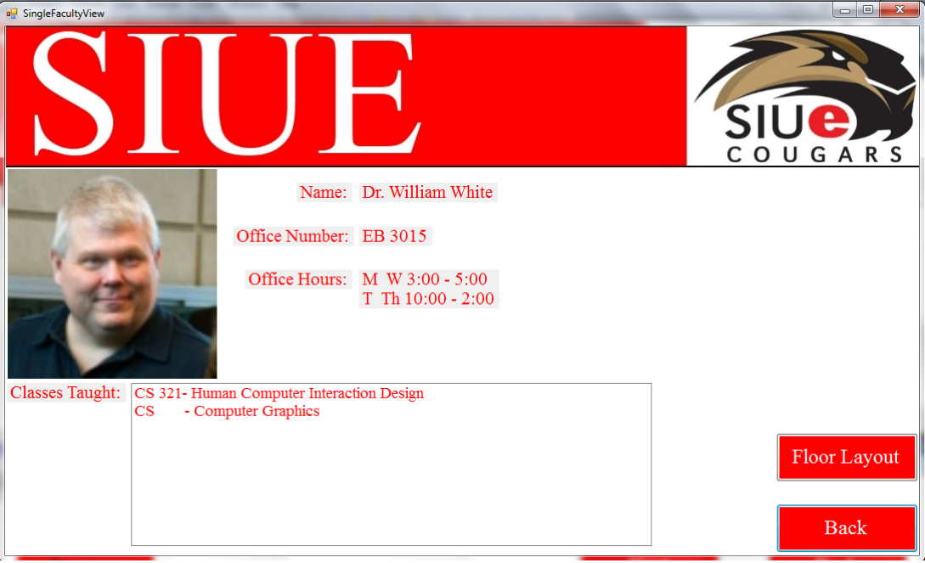
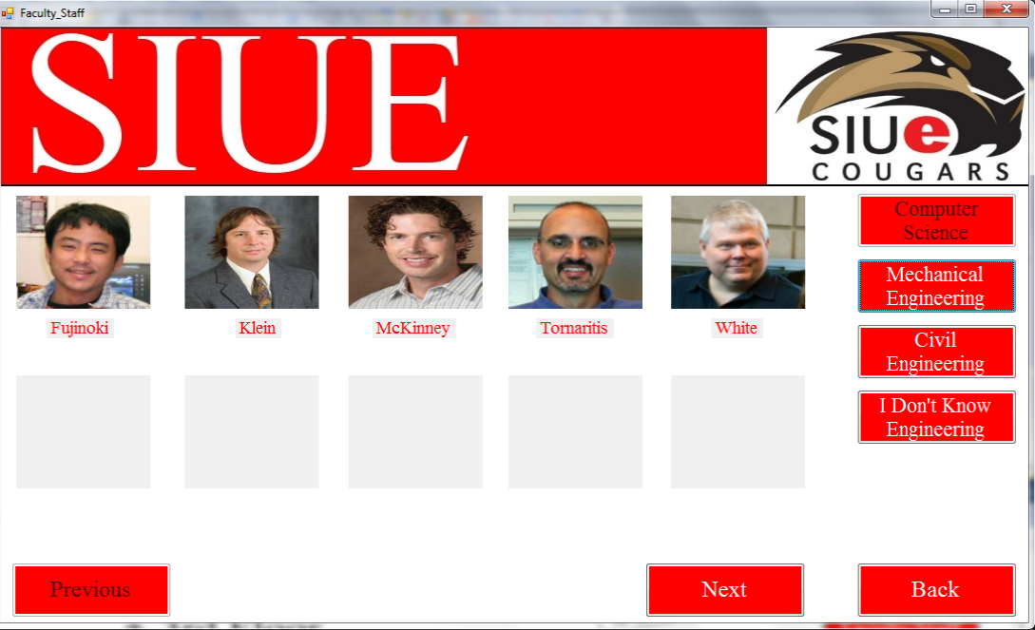
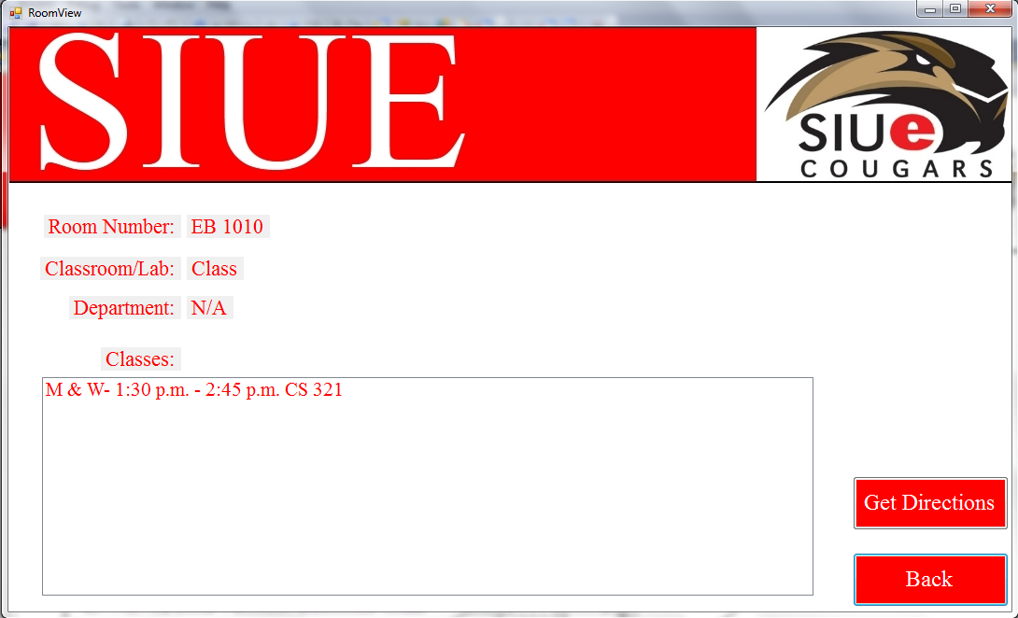

Slide 13
Ultimately, wanted to know if layout was confusing.
How the user will instinctively select an instructor
How the user will instinctively select a room
If there should be more than one way to view the rooms
If the information displayed in the room and faculty windows was easy to read
Make sure the interface did not seem cluttered in any way

Slide 14
Found that interface was easy to use
Was not cluttered, visually
Tapped picture to open faculty information
Clicked on the map to open room information
Users liked the simplicity of the layout
The banner was too large, taking up valuable real estate
List staff names for the offices
Give multiple ways to view the rooms
Users “clicked” the back button instead of using the faster floor layout button
Have directions be easier to find
Some wording was confusing

Slide 15
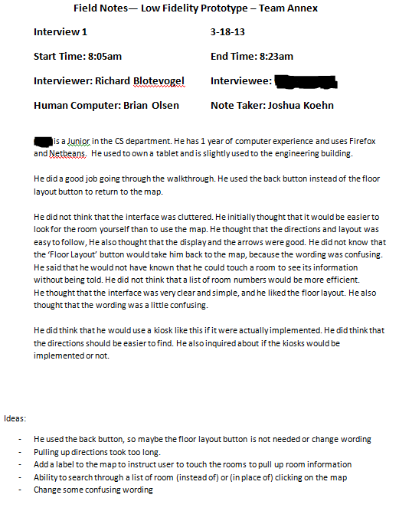

Slide 16
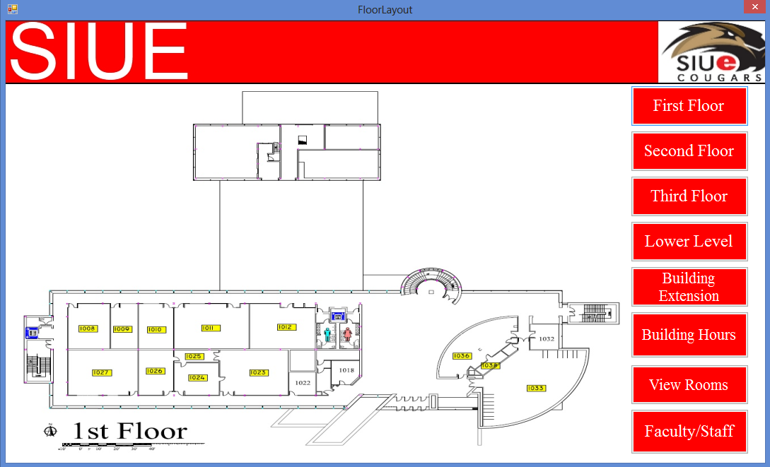
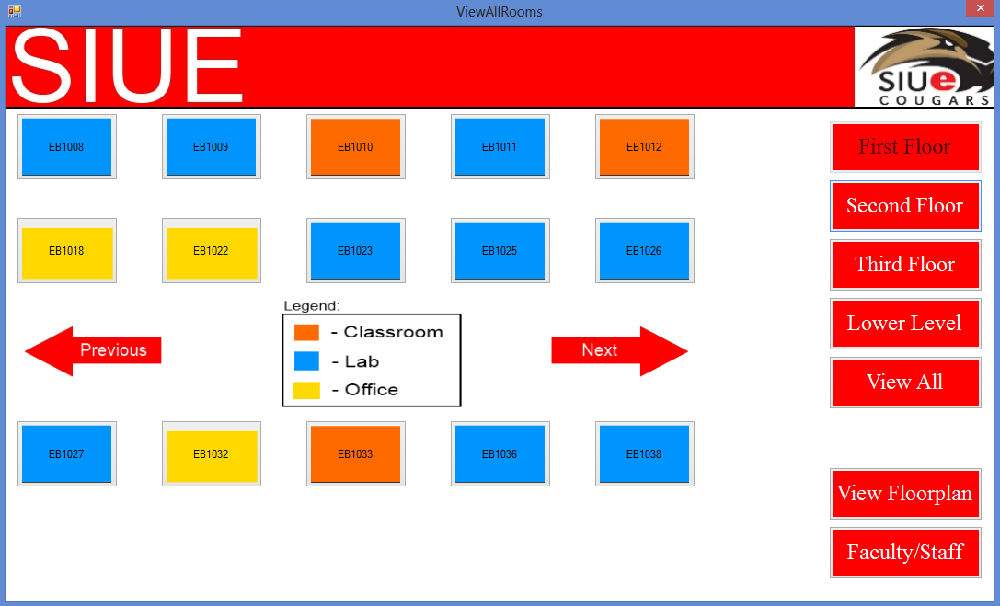
Changed wording
Image mapping
More buttons
New Form
Interview questions…..

Slide 17
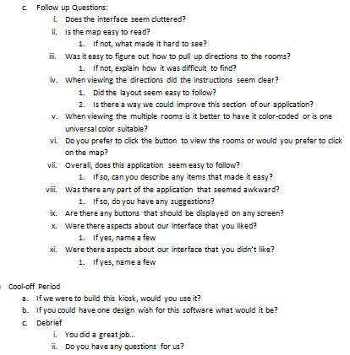
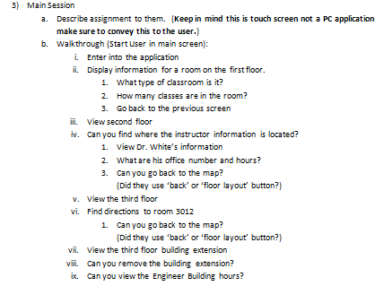
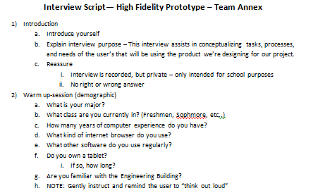

Slide 18
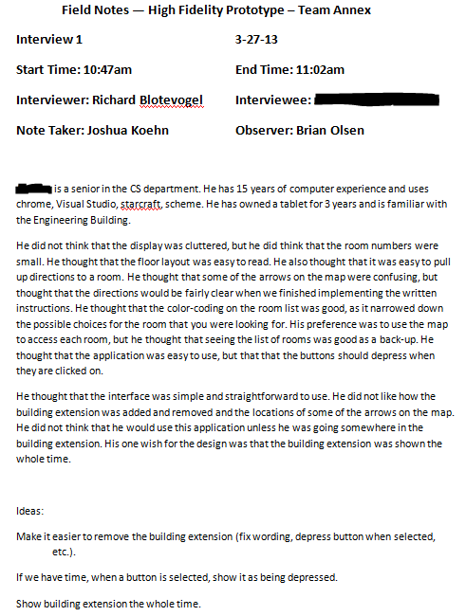
Interview 1
Interview 2
Interview 3
Notes
Simple
Small room numbers
Preferred to use map
Notes
Preferred to use map
Liked the directions
Didn’t like the number of windows
Notes
Liked arrows on map
Didn’t like building extension button
Ideas
Depress buttons
Change building extension
Ideas
Decided to fully implement image mapping
Ideas
Change how we select and show the building extension

Slide 19
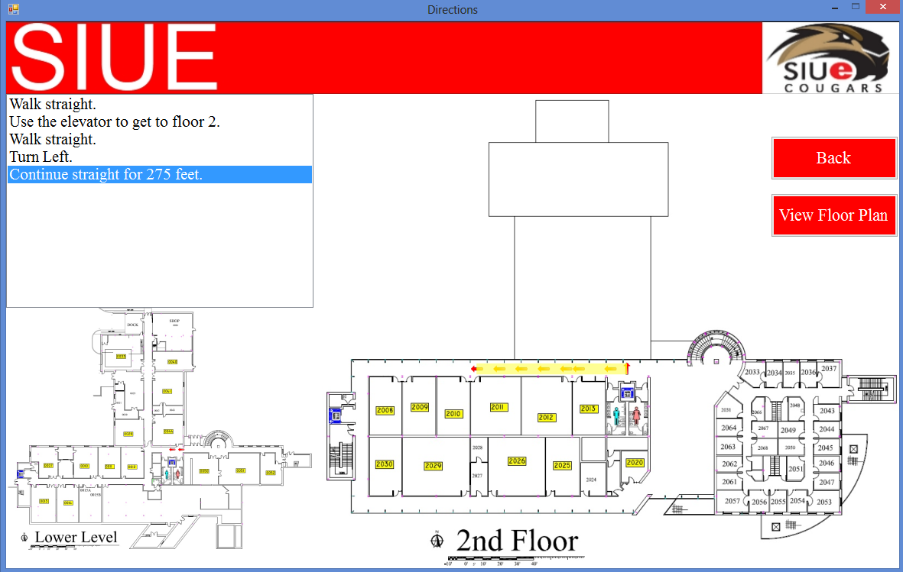
Notes:
Here I am going to guide the class along with me with some guided questions...(i.e. where would you all assume we could click next) this will of course be if time permits…we should also get Dr. White’s

